Slide 1
Title- Navigating Customer Relationship: Bank Journey
Varsha Jaiswal

Slide 2
Introduction
In the bustling world of banking, a bank found itself armed with a large customer data. With this data, it embarked on a mission to keep customers happy, prevent them from leaving, and provide top-notch service.Our protagonist, a leading bank, seeks not just to navigate through data but to unveil insights that will guide its endeavors to reduce churn, elevate service quality, and foster lasting customer satisfaction.

Slide 3
The Problem of Customers Leaving
The bank noticed that some customers were leaving. They looked at their data and saw some signs that showed when a customer might leave. These signs included things like not using their account much, having less money in their account, and not talking to customer service. So, to reduce the churn rate the bank wants to know the pattern or insight about the customers who are leaving the bank.

Slide 4
Understanding the problem
Item 1
Item 2
Item 3
Understanding the customer relationship with the bank is crucial for identifying service-related gaps. To achieve this, we have been provided with a dataset to analyze.
We need to first understand the CRM to reduce the churn rate and maintain the retention rate. We also need to identify the patterns among customers leaving the bank and the factors involved in churn.
So that the bank can make decisions about offers and services, as well as understand service gaps and the reasons for churn, ultimately enhancing customer satisfaction.

Slide 5
Finding answer in the data through visualization

Slide 6
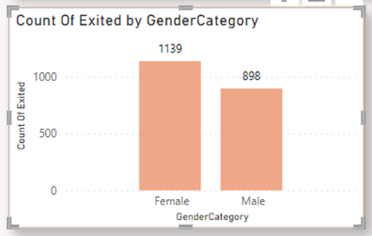
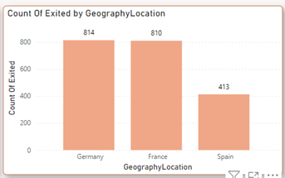
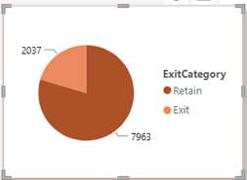
20.37 % Customers had already churn the bank.
Germany and France have the highest no of churn.
Females are more likely to churn.

Slide 7
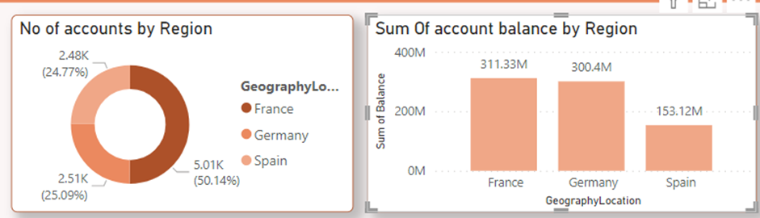
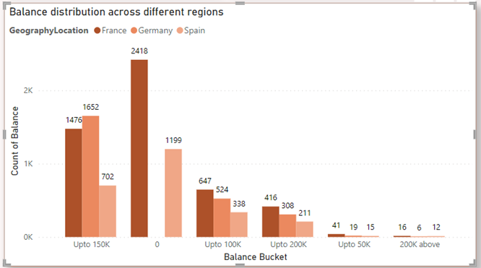
France have the highest no of accounts (50%).
The Sum of Amount for Germany and France are almost same how come?Germany doesn’t allow 0 balance accounts. While france and spain does

Slide 8
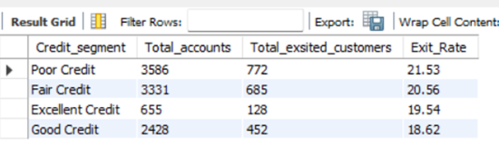
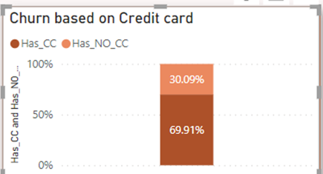

Customers with poor credit score have the highest Exit rate.
France has the highest no of Active accounts.
70% customers have CC.

Slide 9
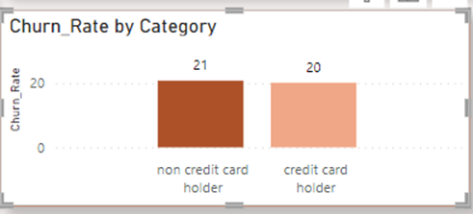
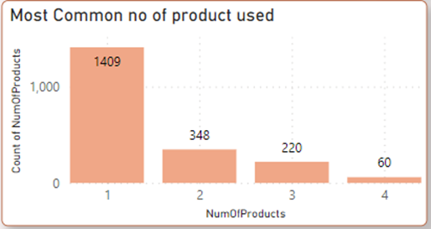

There is only 1% of difference between churn rate of persons with CC and without CC.
Only one product used by customers with churn.
Max Average tenure based on age is 4.8.

Slide 10
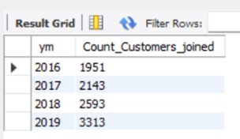
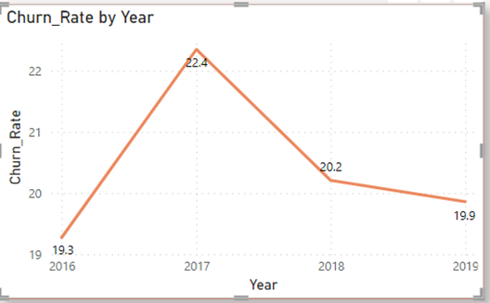
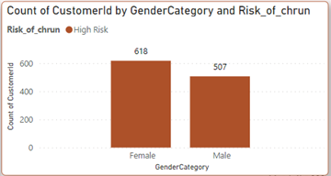
2019 year has the highest no of customers joining the bank then 2018.
So we can say that as the year want the joining rate also increased.
2017 has the highest churn rate than other years.
Female has the highest risk of churn.

Slide 11
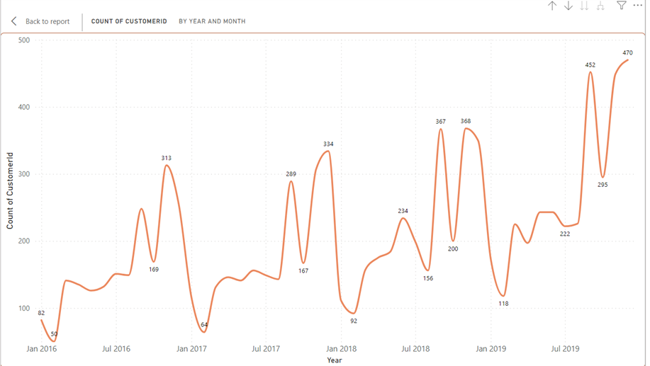
M shape in the graph means that for every year same months the new customers are joining and the months are September, November and December.

Slide 12
Highest
Spain
France
Medium
Lowest
Germany
797
431
399
No of Active accounts in the data.
France→ Spain→ Germany

Slide 13

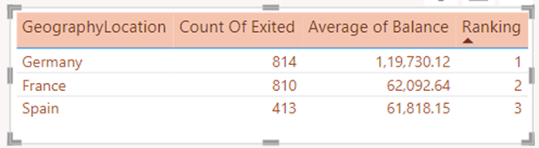
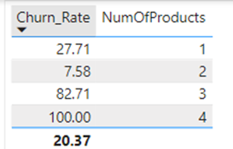
Customer with credit score between 501-700 has the highest no of churn.
Germany have the highest no of churns.
Customers who have used 3 product have the highest churn rate.

Slide 14
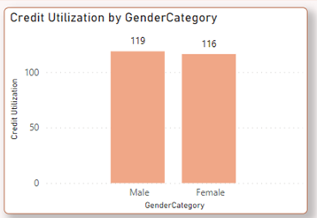
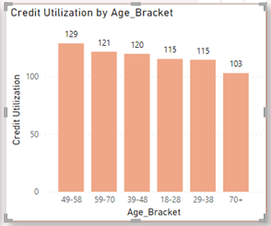
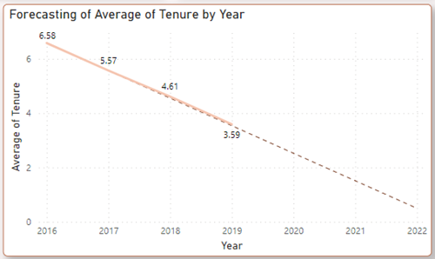
Male has the highest credit card utilization than female but as we can see the difference is very less between the to gender.
Age bucket 49-58 has the highest credit card utilization.
As the year increasing the average tenure is also decreasing.

Slide 15
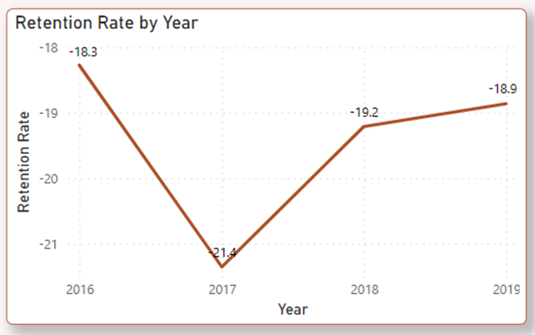
2017 has the highest retention rate and also have the churn rate.
2016 has the lowest retention rate and also has the churn rate.

Slide 16
Insights from the data
Location based Churn – Germany has the highest churn rate.
Gender based churn – Females have the highest churn rate
Age based Churn- age between 40-52 have the highest churn.
Tenure based Churn – Tenure of 4-5 customers has most of the churn.
Is Active Accounts churn - lower no of active accounts contributes to higher exit count

Slide 17
Making Service better
As the bank understood that what are the similar pattern between the customers churning the bank and to make them happy they can get feedbacks from the customers and timely bases so that the customers can be satisfied with the service and will not churn.
Bank can see the insight and focus on the customers who might leave to know the what are the gaps in the service.
If the customers is having any problem than bank can solve problem quickly and nicely making things customers easy to understand.

Slide 18
Conclusion
So, the bank decided to use what they learned from their data to make things better. They wanted to keep their customers happy, stop them from leaving, and make their service the best it could be. With this new understanding, the bank was ready to make a difference in their customers' lives
And that's the story of how a bank used its data to make its customers happy. It's a story that never ends, as the bank keeps finding new ways to make its customers smile and keep them satisfied by understanding their feedback and data.

Slide 19
THANK YOU !!!

